Slide 1
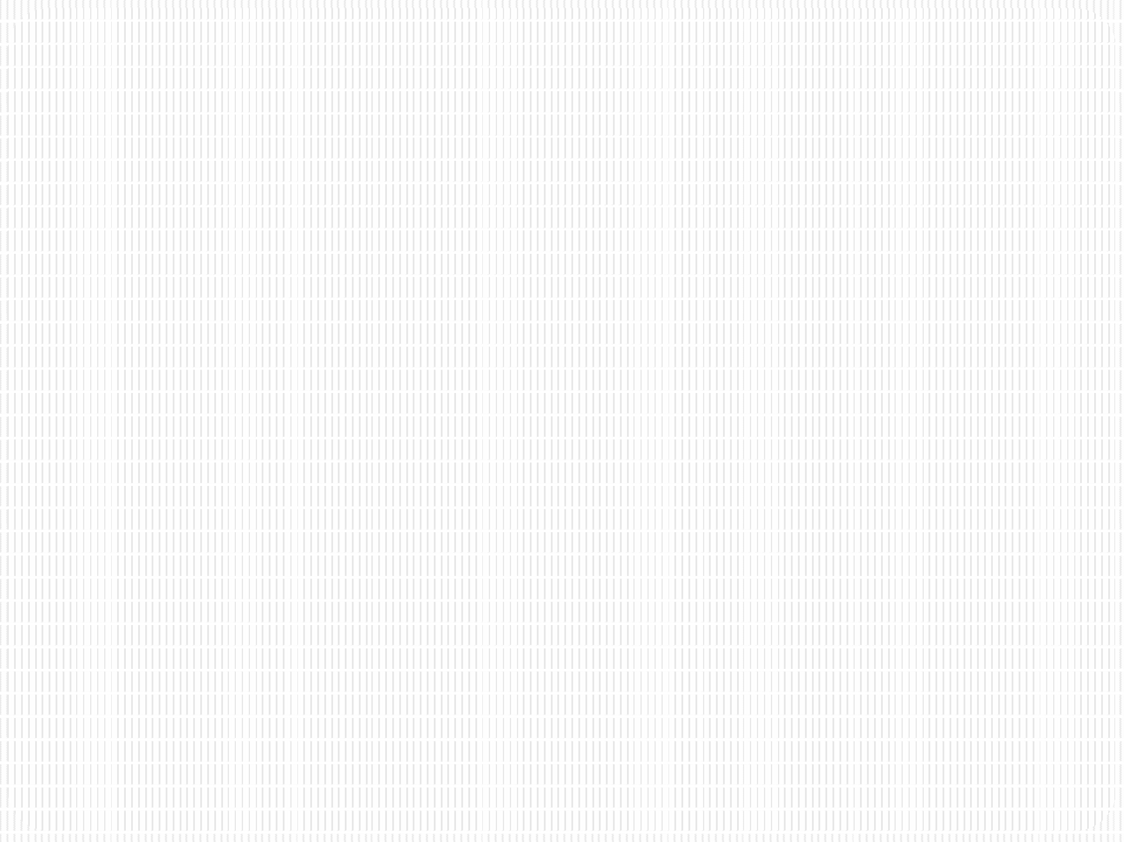


SRM INSTITUTE OF SCIENCE AND TECHNOLOGY
21CSC201J – Data Structures and Algorithms
Unit III- QUEUE

Slide 2

QUEUES
A queue is a data structure that models/enforces the first-come first-serve order, or equivalently the first-in first-out (FIFO) order.

Slide 3
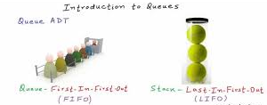
What is a Queue???????????
That is, the element that is inserted first into the queue will be the element that will deleted first, and the element that is inserted last is deleted last.

Slide 4
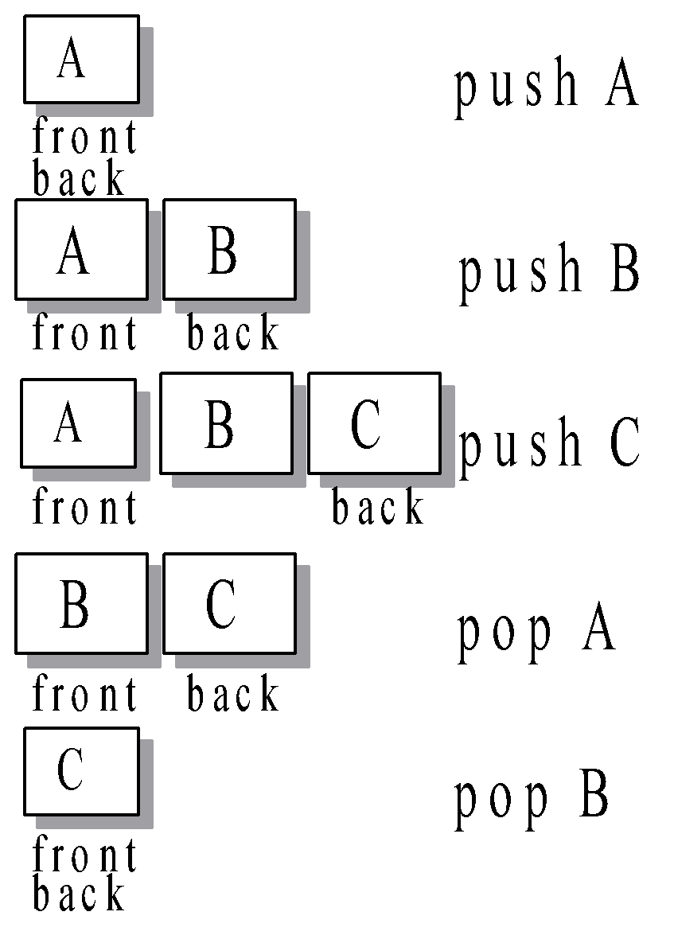
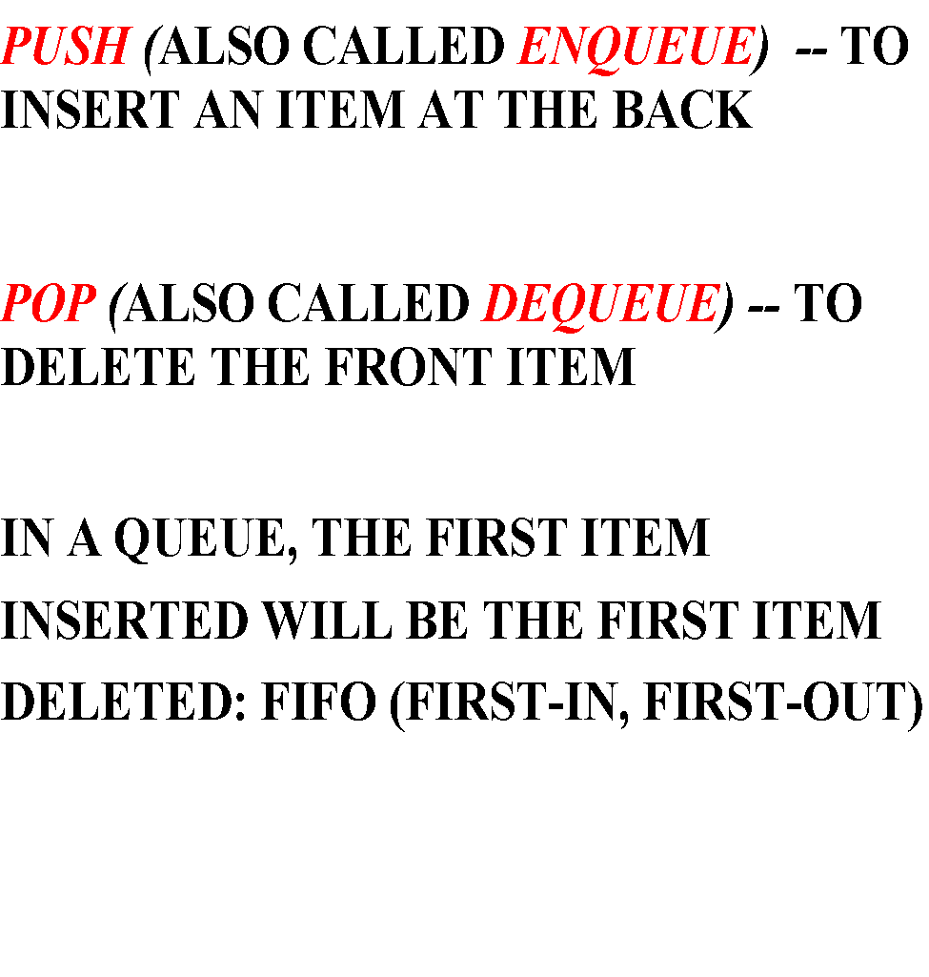
OPERATIONS OF A QUEUE

Slide 5
The Queue Operations
A queue is like a line of people waiting for a bank teller. The queue has a front and a rear.
Front (Head)
Rear (Tail)

Slide 6
Operations on Queues
Insert(item): (also called enqueue)
It adds a new item to the tail of the queue
Remove( ): (also called delete or dequeue)
It deletes the head item of the queue, and returns to the caller. If the queue is already empty, this operation returns NULL
getHead( ):
Returns the value in the head element of the queue
getTail( ):
Returns the value in the tail element of the queue
isEmpty( )
Returns true if the queue has no items
size( )
Returns the number of items in the queue

Slide 7
Creation of Queue
Module Create Queue
count = 0
front = -1
rear= -1
End Module Create Queue

Slide 8
enQueue(value) - Inserting value into the queue
Step1: Check whether queue is FULL. (rear == SIZE-1)
Step 2: If it is FULL, then display "Queue is FULL!!! Insertion is not possible!!!" and terminate the function.
Step 3: If it is NOT FULL, then increment rear value by one (rear++) and set queue[rear] = value.

Slide 9
Array Implementation
The easiest implementation also keeps track of the number of items in the queue and the index of the first element (at the front of the queue), the last element (at the rear).
3
size
0
first
2
last
[ 0 ]
[1]
[ 2 ]
[ 3 ]
[ 4 ]
[ 5 ]
. . .
4
8
6

Slide 10
Array Implementation
A queue can be implemented with an array, as shown here. For example, this queue contains the integers 4 (at the front), 8 and 6 (at the rear).
[ 0 ]
[1]
[ 2 ]
[ 3 ]
[ 4 ]
[ 5 ]
. . .
4
8
6
An array of integers to implement a queue of integers
We don't care what's in
this part of the array.

Slide 11
An Enqueue Operation
When an element enters the queue, size is incremented, and last changes, too.
3
size
1
first
3
last
[ 0 ]
[1]
[ 2 ]
[ 3 ]
[ 4 ]
[ 5 ]
. . .
8
6
2

Slide 12
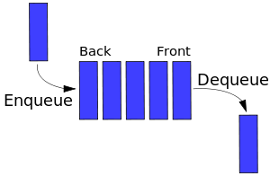
Queue Insertion
void enQueue(int value)
{
if(rear == SIZE-1)
printf("\nQueue is Full!!! Insertion is not possible!!!");
else
{
if(front == -1)
front = 0;
rear++;
queue[rear] = value;
printf("\nInsertion success!!!");
}

Slide 13
deQueue() - Deleting a value from the Queue
Step 1: Check whether queue is EMPTY. (front == rear)
Step 2: If it is EMPTY, then display "Queue is EMPTY!!! Deletion is not possible!!!" and terminate the function.
Step 3: If it is NOT EMPTY, then increment the front value by one (front ++). Then display queue[front] as deleted element. Then check whether both front and rear are equal (front == rear), if it TRUE, then set both front and rear to '-1' (front = rear = -1).

Slide 14
A Dequeue Operation
When an element leaves the queue, size is decremented, and first changes, too.
2
size
1
first
2
last
[ 0 ]
[1]
[ 2 ]
[ 3 ]
[ 4 ]
[ 5 ]
. . .
4
8
6

Slide 15
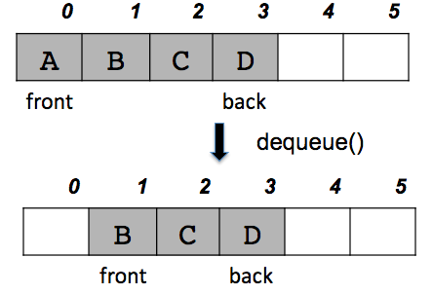
Queue Deletion
void deQueue()
{
if(front == rear)
printf("\nQueue is Empty!!! Deletion is not possible!!!");
else
{
printf("\nDeleted : %d", queue[front]);
front++;
if(front == rear)
front = rear = -1;
}
}

Slide 16
display() - Displays the elements of a Queue
Step 1: Check whether queue is EMPTY. (front == rear)
Step 2: If it is EMPTY, then display "Queue is EMPTY!!!" and terminate the function.
Step 3: If it is NOT EMPTY, then define an integer variable 'i' and set 'i = front'.
Step 3: Display 'queue[i]' value and increment 'i' value by one (i++). Repeat the same until 'i' value is equal to rear (i <= rear)

Slide 17
Queue Display
void display()
{
if(rear == -1)
printf("\nQueue is Empty!!!");
Else
{
int i;
printf("\nQueue elements are:\n");
for(i=front; i<=rear; i++) printf("%d\t",queue[i]);
}
}

Slide 18

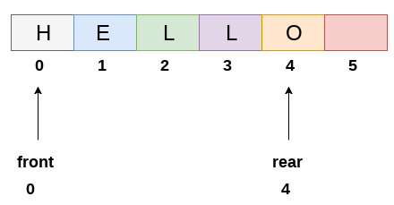
Array Implementation of Queues
Queue can be implemented using a one- dimensional array.
We need to keep track of 2 variables: front
and rear
front is the index in which the first element is present
rear is the index in which the last element is present

Slide 19
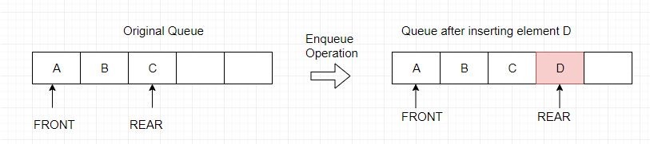
Enqueue in Array Implementation of Queue
//Basic Idea
enqueue(num):
rear++ queue[rear]=num return
Time Complexity: O(1)

Slide 20
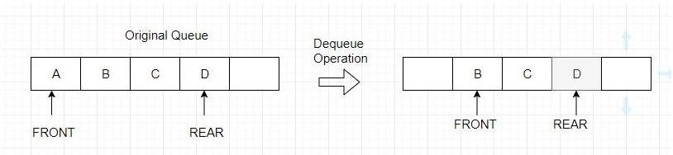
Dequeue in Array Implementation of Queue
//Basic Idea dequeue():
Time Complexity: O(1)
O(n) if elements are
shifted
num = queue[front] front++
return num

Slide 21
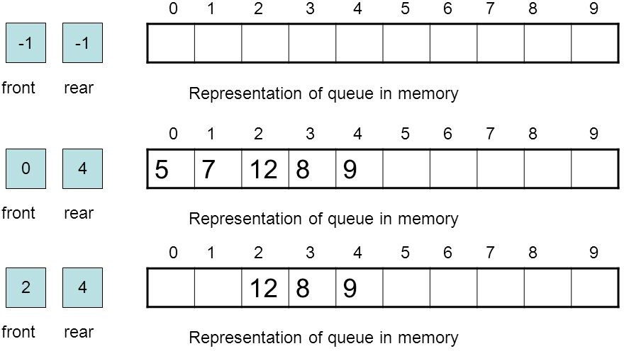
Enqueue and Dequeue in Queue

Slide 22
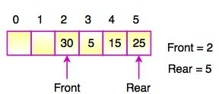
Disadvantage of Array Implementation of Queue
Multiple enqueue and dequeue operations may lead to situation like this:
No more insertion is possible (since rear cannot be incremented anymore) even though 2 spaces are free.
Workaround: Circular Queue, Shifting elements after each dequeue

Slide 23
LINKED LIST REPRESENTATION OF QUEUES
The array implementation cannot be used for the large scale applications where the queues are implemented. One of the alternative of array implementation is linked list implementation of queue.
In a linked queue, each node of the queue consists of two parts i.e. data part and the link part. Each element of the queue points to its immediate next element in the memory.
In the linked queue, there are two pointers maintained in the memory i.e. front pointer and rear pointer. The front pointer contains the address of the starting element of the queue while the rear pointer contains the address of the last element of the queue.
Insertion and deletions are performed at rear and front end respectively. If front and rear both are NULL, it indicates that the queue is empty.

Slide 24
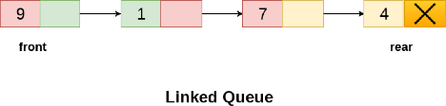
LINKED LIST REPRESENTATION OF QUEUES
Operations on Linked
The linked representation of queue is
Queue
shown in the following figure.
There are two basic
operations which can be implemented on the linked queues.
The operations are Insertion and Deletion.

Slide 25
Implementing Queue ADT: Circular Array Queue
Neat trick: use a circular array to insert and remove items from a queue in constant time.
The idea of a circular array is that the end of the array “wraps around” to the start of the array.
7
0
6
1
5
2
4
3
Q:
0
size - 1
b
c
d
e
f
front
back

Slide 26
Circular Array Queue
Q:
0
size - 1
b
c
d
e
f
front
back
// Basic idea!
enqueue(x) {
Q[back] = x;
back = (back + 1) % size
}
/ Basic idea!
dequeue() {
x = Q[front];
front = (front + 1) % size;
return x;
}

Slide 27
Exercise: Linked List Queue Implementation
Implement a queue class that stores String values using a singly linked list with both nodes to indicate the front and the back of the queue as below. The queue should implement the interface on the next slide.
b
c
d
e
f
front
back

Slide 28
Operation on Linked Queue
There are two basic operations which can be implemented on the linked queues. The operations are Insertion and Deletion.
Algorithm for Insertion
Step 1: Allocate the space for the new node PTR
Step 2: SET PTR -> DATA = VAL
Step 3: IF FRONT = NULL SET FRONT = REAR = PTR SET FRONT -> NEXT = REAR -> NEXT = NULL ELSE SET REAR -> NEXT = PTR SET REAR = PTR SET REAR -> NEXT = NULL [END OF IF]
Step 4: END

Slide 29
Algorithm for Deletion
Step 1: IF FRONT = NULL Write " Underflow " Go to Step 5 [END OF IF]
Step 2: SET PTR = FRONT
Step 3: SET FRONT = FRONT -> NEXT
Step 4: FREE PTR
Step 5: END

Slide 30
Sample Question
1.How many stacks are required to implement a queue? Where no other data structure like arrays or linked lists is available.
1
2
3
4
Solution: b. 2.
2. Is the statement true about linked list implementation of the Queue?
In a push operation, if new nodes are inserted at the beginning of the linked list, then in pop operation and nodes must be removed from the end.
In a push operation, if new nodes are inserted at the end, then in pop operation, nodes must be removed from the beginning.
Both of the above
None of the above
Solution: c. Both of the above
As First In First Out order, a queue can be implemented using a linked list in any of the given two ways.

